Slide 1
Introduction of Kitchen waste collection in City of Bratislava

Slide 2
https://bratislava.blob.core.windows.net/ media/Default/Dokumenty/Odpadove_hospodarsto_2.pdf

Slide 3
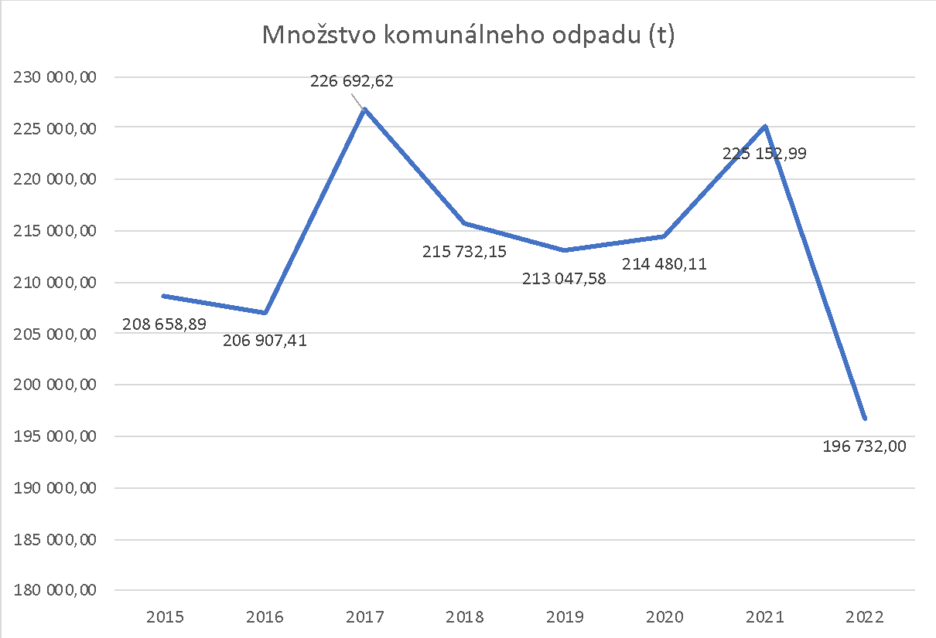
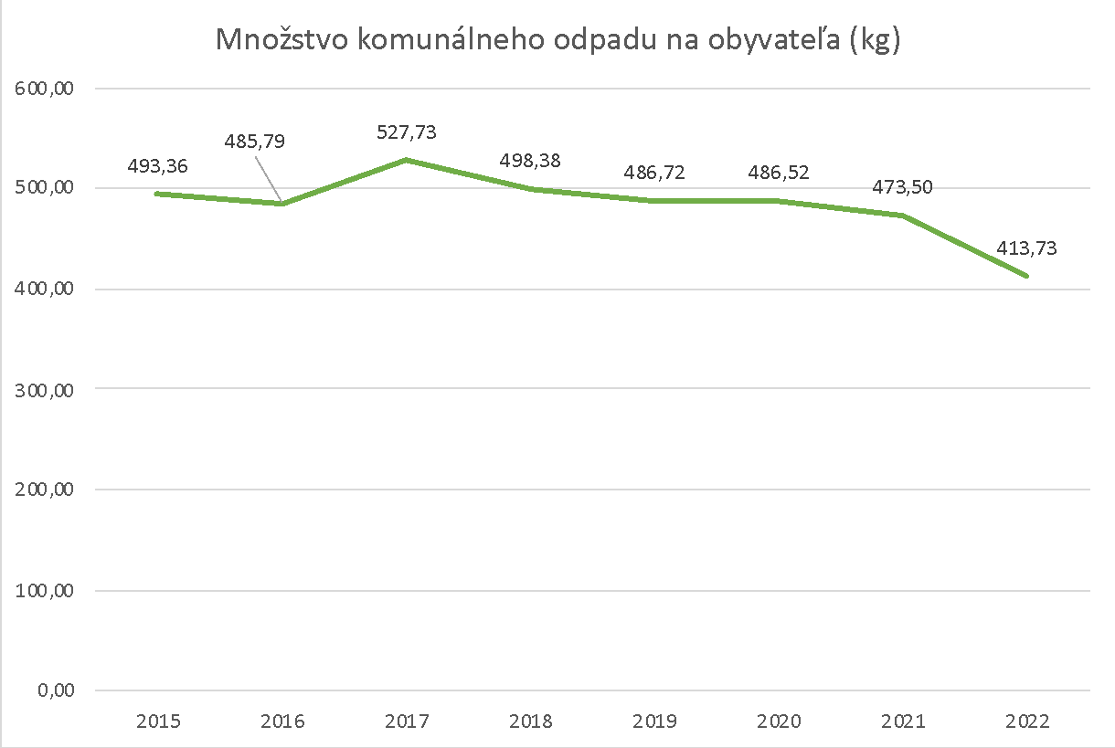
Waste amounts in Bratislava
Municipal waste: 196 732 tons
Waste per capita: 413, 73 kg

Slide 4
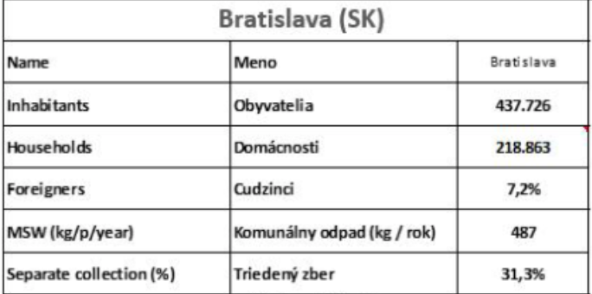

Slide 5
Introduction of KW collection was the biggest change in waste collection for the past two decades

Slide 6
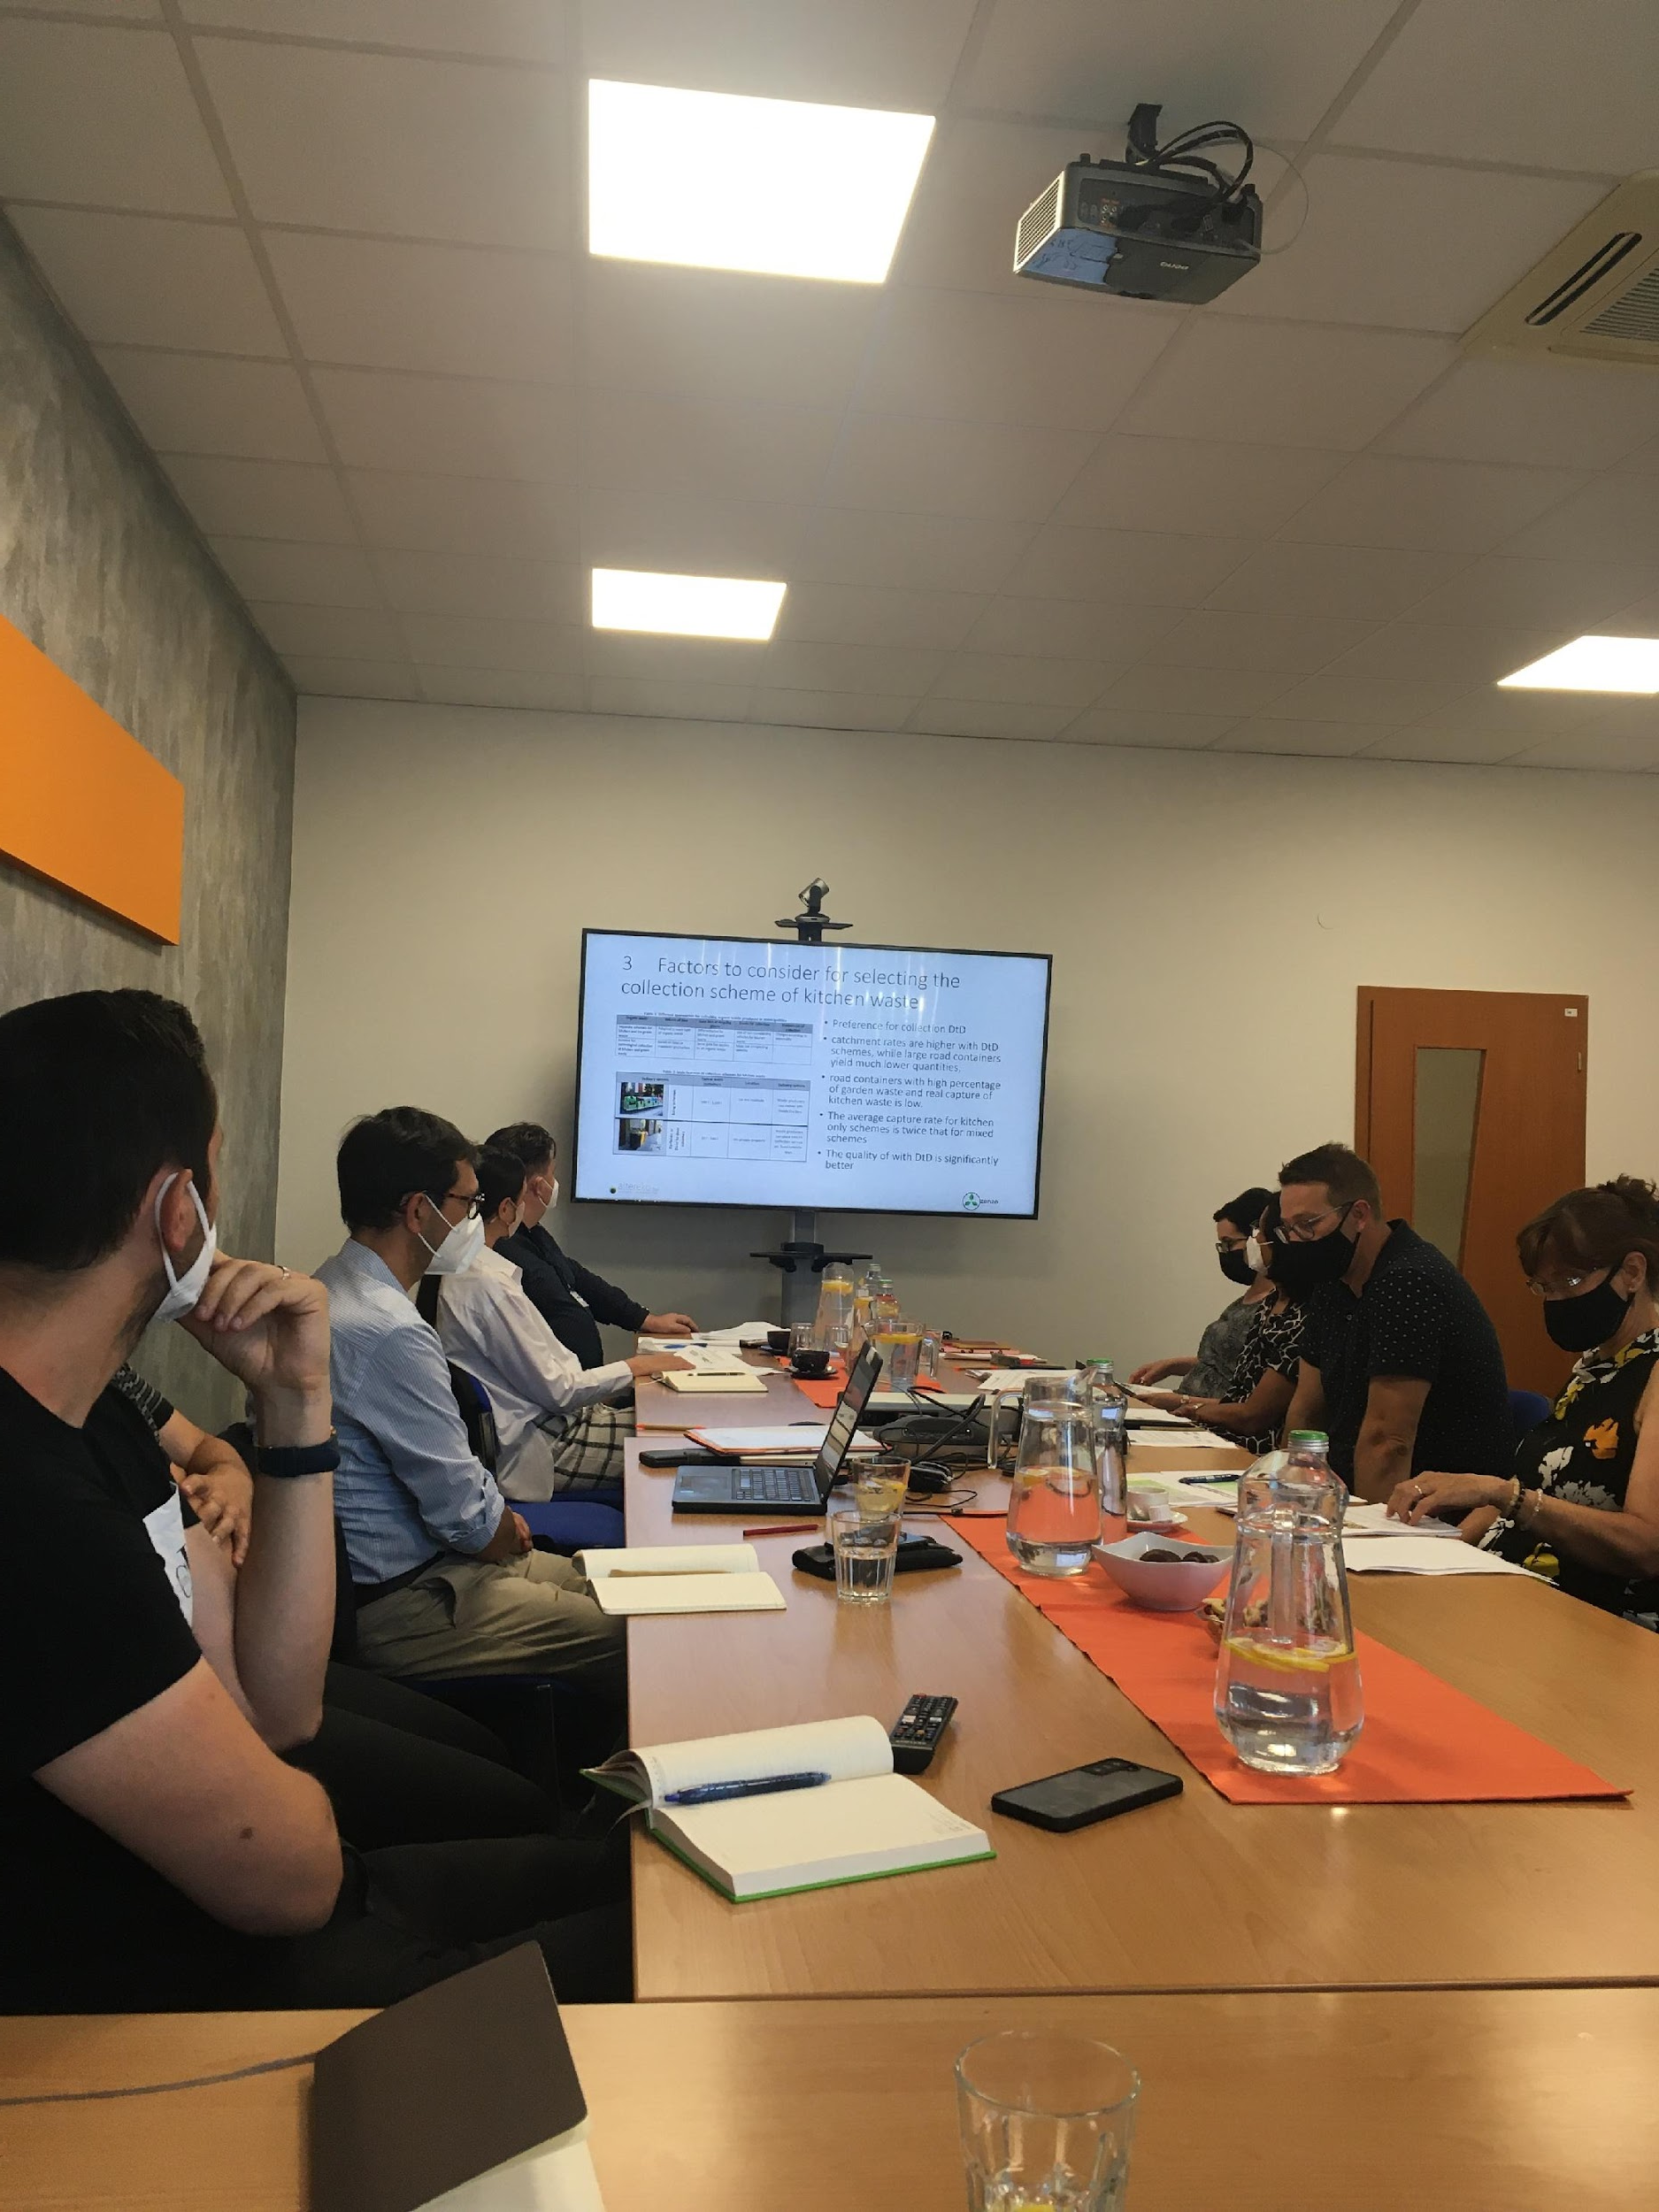
How we started?
Autumn 2020: public procurement for the Study on Kitchen Waste
Ppreparation of the study from OZ Zenzo: November 2020 – June 2021
preparation of local Waste Acr: April 2021 – September 2021
Preparation of pilot project in Lamač – August 2021
Distribution of kitchen caddys and bins in Lamač: September 2021
Start of the KW collection in Lamač: október 2021
Preparation of the introduction of KW collection in the city of Bratislava : November 2021 – March 2022
Start of the distribution, communication and kitchen waste collection in city districts: March 2022

Slide 7
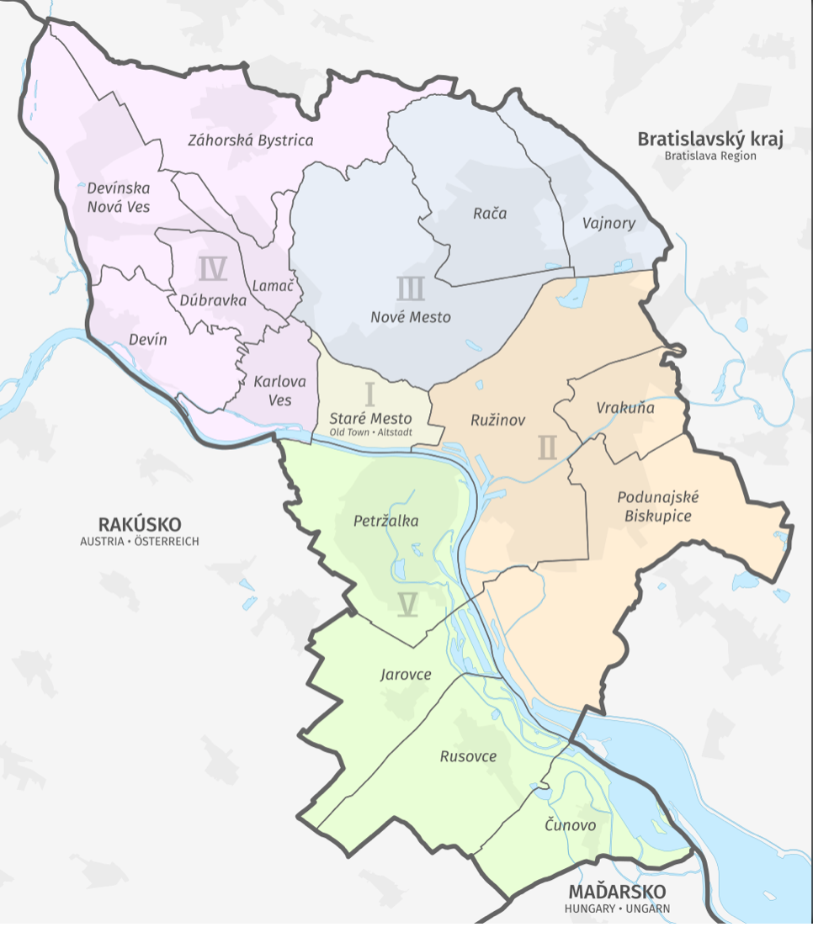
Time schedule of the project
MČ | ZAČIATOK DISTRIBÚCIE | KONIEC DISTRIBÚCIE | OPAKOVANÁ DISTRIBÚCIA | DISTRIBUČNÉ CENTRUM | ZBER
1. ZÁHORSKÁ BYSTRICA | 1.3.2022 | 12.3.2022 | 7.3-18.3.2022 | 5.3. a 12.3.2022 VYTIPOVANIE MIEST MČ | 14.3.2022
2. KARLOVA VES | 14.3.2022 | 4.4.2022 | 21.3.-8.4.2022 | 26.3., 2.4. a 9.4.2022 VYTIPOVANIE MIEST MČ | 4.4.2022
3. DÚBRAVKA | 5.4.2022 | 23.4.2022 | 11.4.-29.4.2022 | 16.4., 23.4. a 30.4.2022 VYTIPOVANIE MIEST MČ | 25.4.2022
4. DEVÍNSKA NOVÁ VES | 25.4.2022 | 5.5.2022 | 2.5-6.5.2022 | 30.4. a 7.5.2022 VYTIPOVANIE MIEST MČ | 9.5.2022
5. DEVÍN | 6.5.2022 | 10.5.2022 | 9.5.-13.5.2022 | 7.5. a 14.5.2022 VYTIPOVANIE MIEST MČ | 16.5.2022
6. PETRŽALKA | 11.5.2022 | 8.6.2022 | 16.5.-10.6.2022 | 21.5., 28.5., 4.6. a 11.6.2022 VYTIPOVANIE MIEST MČ | 30.5. a 13.6.2022
7. RUŽINOV | 9.6.2022 | 16.7.2022 | 13.6.-22.7.2022 | 18.6., 25.6., 2.7., 9.7. a 16.7.2022 VYTIPOVANIE MIEST MČ | 27.6. a 18.7.2022
8. NOVÉ MESTO | 18.7.2022 | 13.8.2022 | 25.7.-19.8.2022 | 23.7., 30.7., 6.8., 13.8. a 20.8.2022 VYTIPOVANIE MIEST MČ | 1.8. a 15.8.2022
9. RAČA | 15.8.2022 | 27.8.2022 | 22.8.-2.9.2022 | 20.8. a 27.8.2022 VYTIPOVANIE MIEST MČ | 29.8.2022
10. STARÉ MESTO | 29.8.2022 | 27.9.2022 | 5.9.-30.9.2022 | 3.9., 10.9., 17.9., 24.9. a 1.10.2022 VYTIPOVANIE MIEST MČ | 12.9. a 3.10.2022
11. PODUNAJSKÉ BISKUPICE | 28.9.2022 | 14.10.2022 | 3.10.-14.10.2022 | 8.10. a 15.10.2022 VYTIPOVANIE MIEST MČ | 17.10.2022
12. VRAKUŇA | 15.10.2022 | 29.10.2022 | 17.10.-1.11.2022 | 22.10. a 29.10.2022 VYTIPOVANIE MIEST MČ | 31.10.2022
13. VAJNORY | 31.10.2022 | 9.11.2022 | 2.11.-11.11.2022 | 5.11. a 12.11.2022 VYTIPOVANIE MIEST MČ | 14.11.2022
14. JAROVCE | 10.11.2022 | 15.11.2022 | 14.11.-18.11.2022 | 19.11.2022 VYTIPOVANIE MIEST MČ | 28.11.2022
15. RUSOVCE | 16.11.2022 | 24.11.2022 | 21.11.-25.11.2022 | 26.11.2022 VYTIPOVANIE MIEST MČ | 5.12.2022
16. ČUNOVO | 25.11.2022 | 28.11.2022 | 28.11.-2.12.2022 | 3.12.2022 VYTIPOVANIE MIEST MČ | 5.12.2022

Slide 8
Communication plan of the project
1.
2.
3.
OLO osloví OŽP MČ
OMDaP zašle list na správcov BD o zapojení sa do zberu K-BRO
Magistrát zašle list na starostov MČ
MČ
OŽP MČ
stretnutie
správcovia, MAG, OLO, OŽP MČ
informuje obyvateľov BD
správca
určenie ambasádora pre danú MČ
určenie kontaktných osôb pre operatívu a komunikáciu projektu
zapojí BD podľa platného VZN
ambasádor
objedná 120/240 l ZN
vytipovanie “lokálnych znalcov terénu“
kampaň K-BRO distribúcia balíkov
OLO dodá objednané ZN
komunikácia K-BRO v rámci MČ
vytipovanie spoločenských priestorov na stretnutie so správcami BD a distribučných centrier
príprava informačného letáku a plagátu pre obyvateľov
sociálne siete (FB, Instagram) – MAG, MČ, OLO
miestna TV, rozhlas, noviny, aplikácia MČ
oznamovacie tabule v MČ, billboard
OLO zašle SMS obyvateľom RD

Slide 9
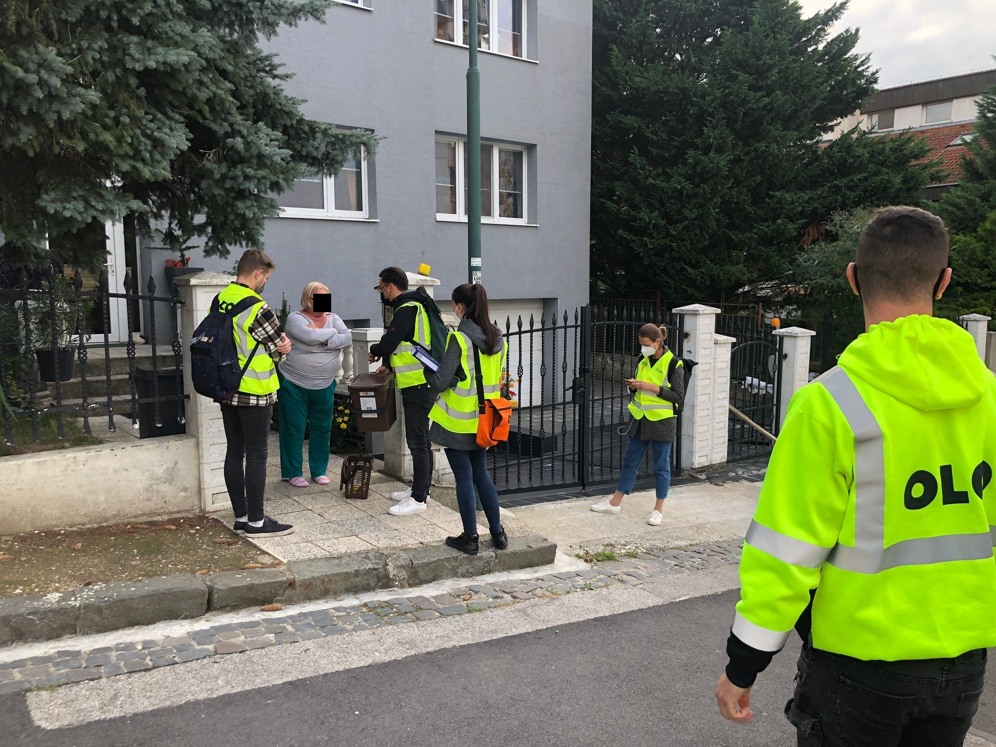
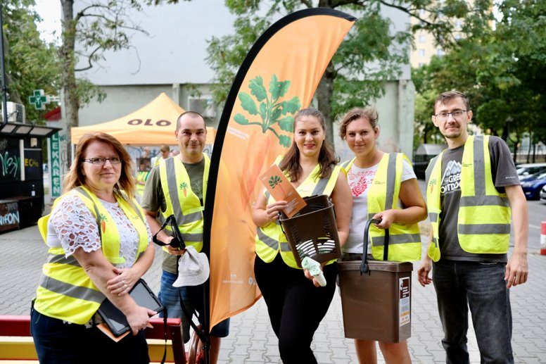
Distribution of kitchen caddys

Slide 10
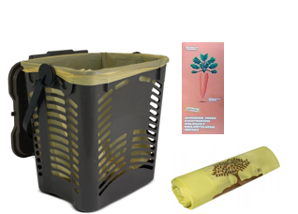
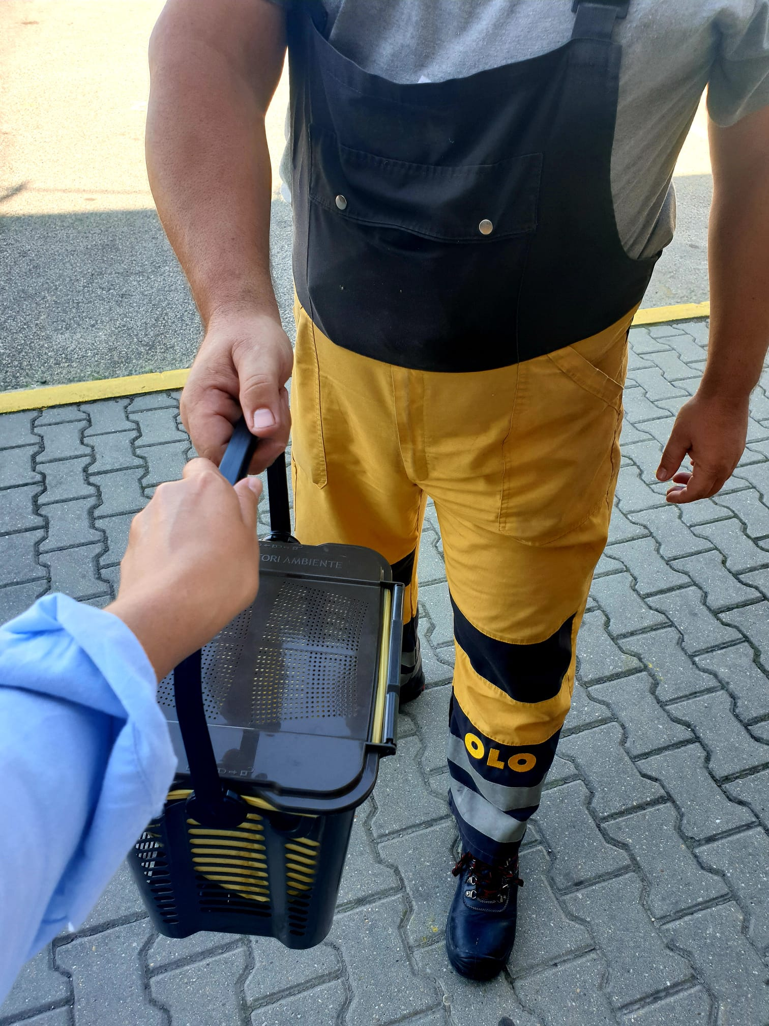
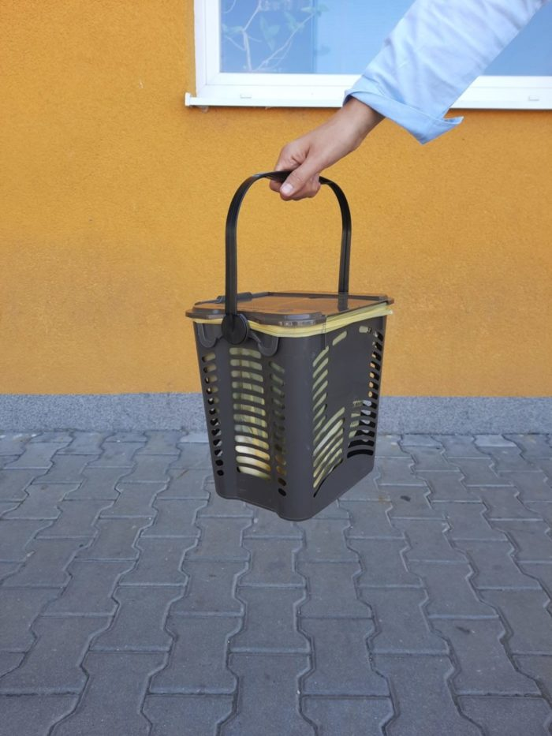
To every household in Bratislava we distributed :
10 l kitchen waste caddy,
150 pc of compostable bags,
Information leaflet (for each city district was different leaflet)

Slide 11
BINS FOR FAMILY HOUSES
20l collection bins will be added for sorting kitchen waste.
Residents put knotted compostable bags of biowaste in these bins.
OLO will collect this type of waste once a week, from March – November 2 times a week.

Slide 12
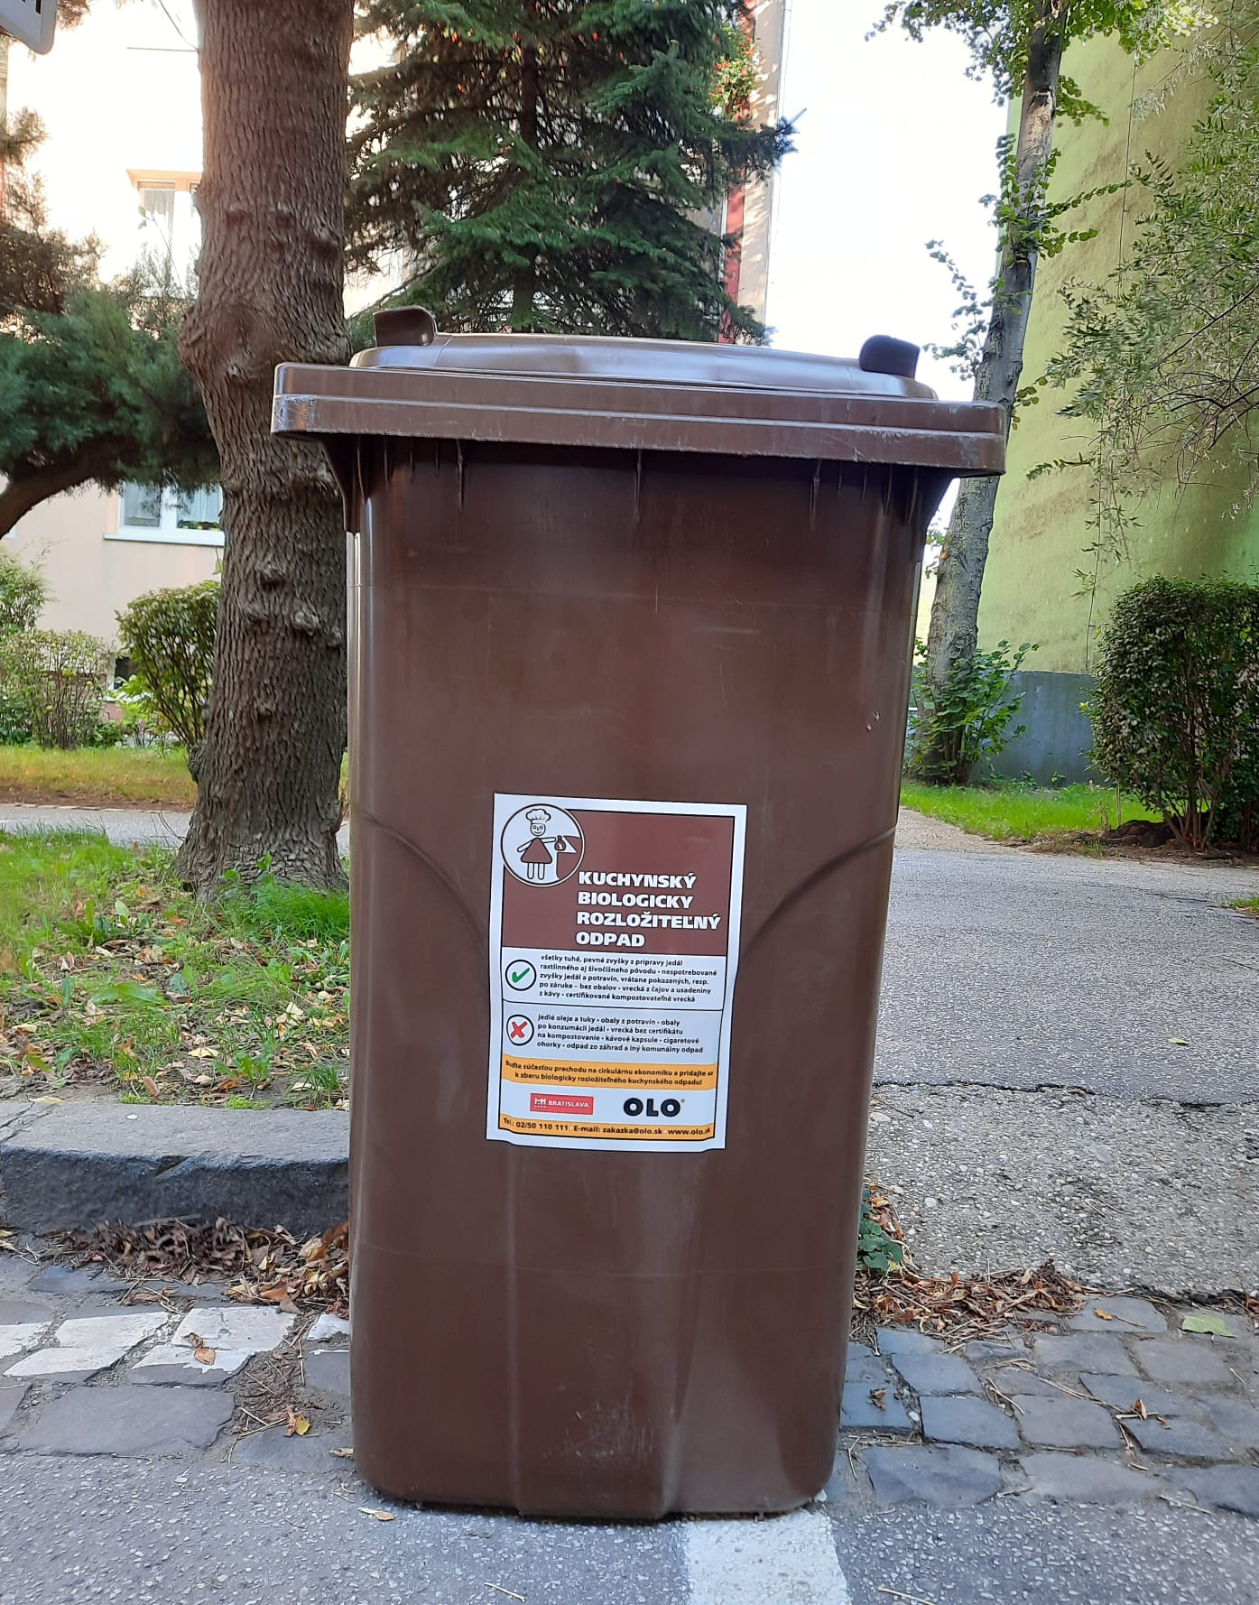
BINS FOR BLOCK OF FLATS
For sorting kitchen waste, common 120 l and 240 l collection containers are added. Residents put knotted compostable bags of biowaste in these bins. OLO collects this type of waste once a week, from March – November 2 times a week. The container is ordered by the apartment building manager from Tax Department and delivered to inhabitants by OLO.
240 l ZN: Šírka: 580 mm, Hĺbka: 707 mm, Výška: 1045 mm

Slide 13
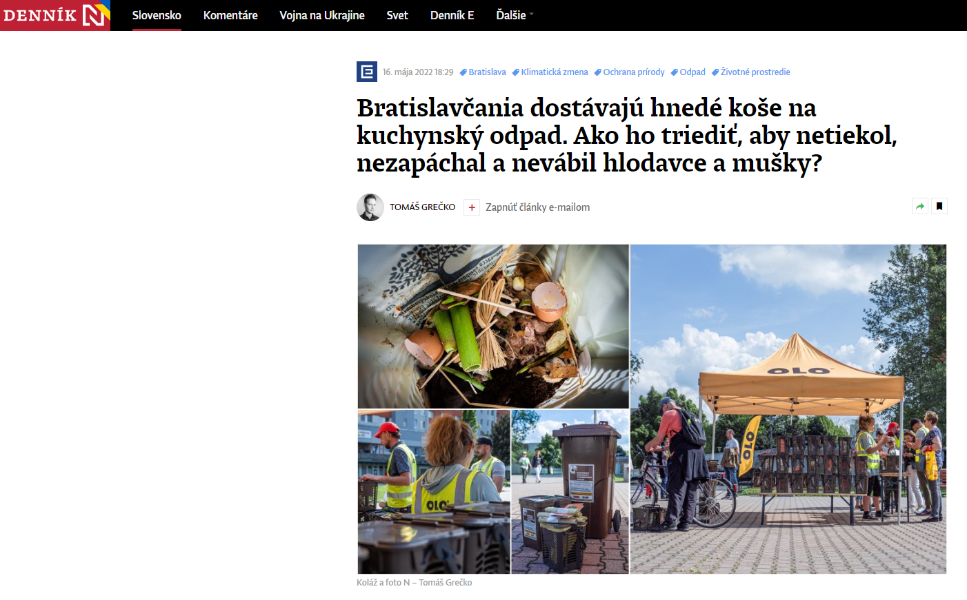
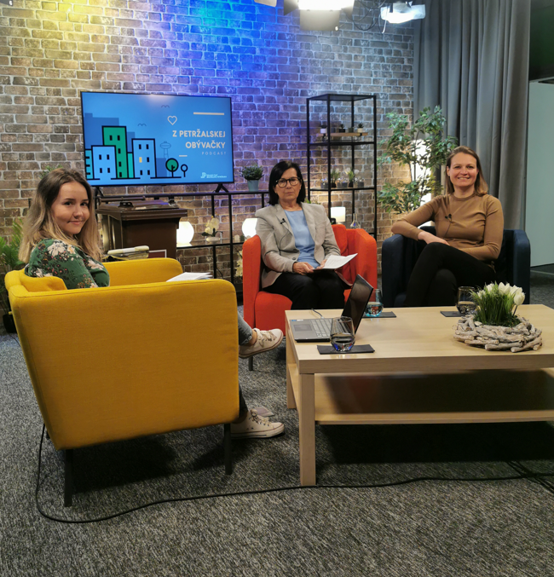
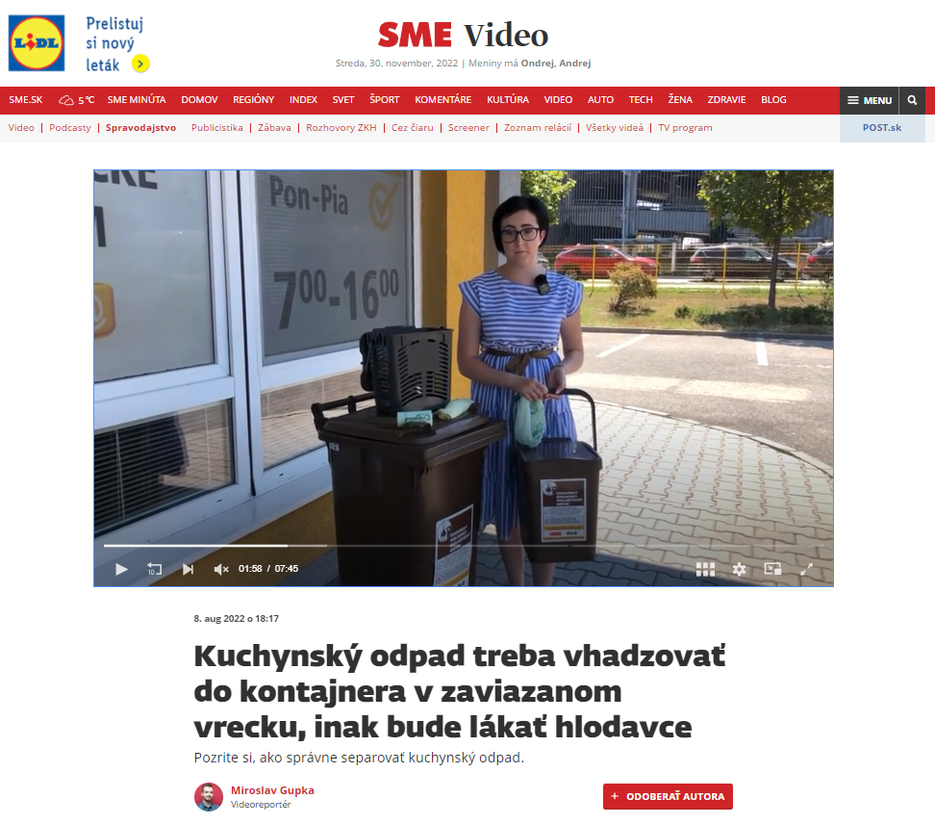
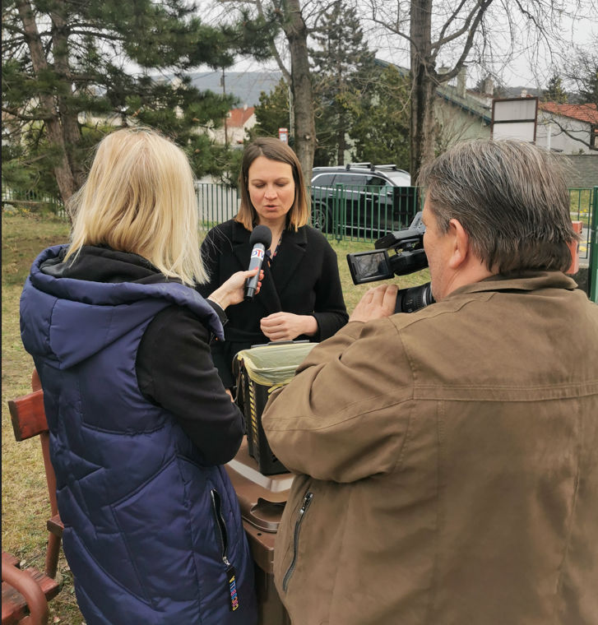
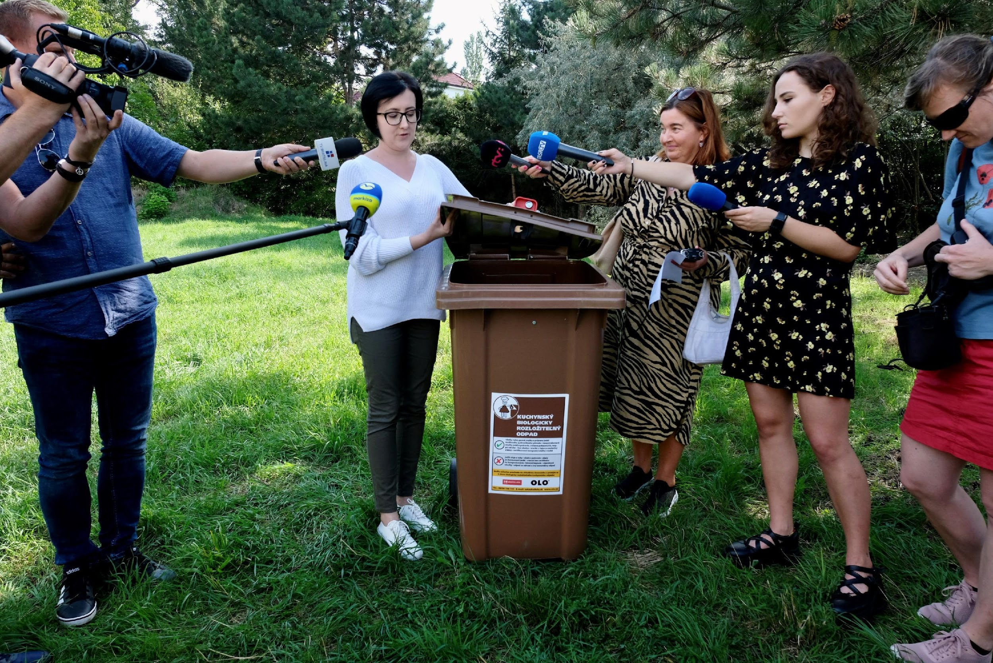
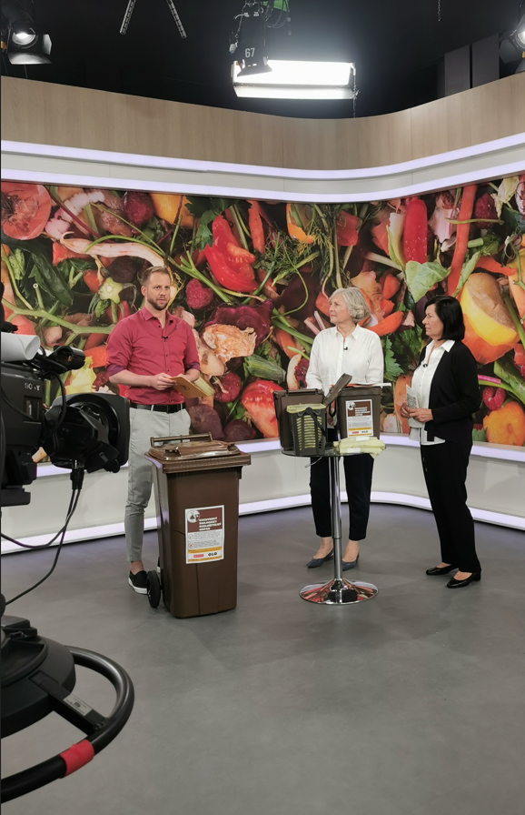
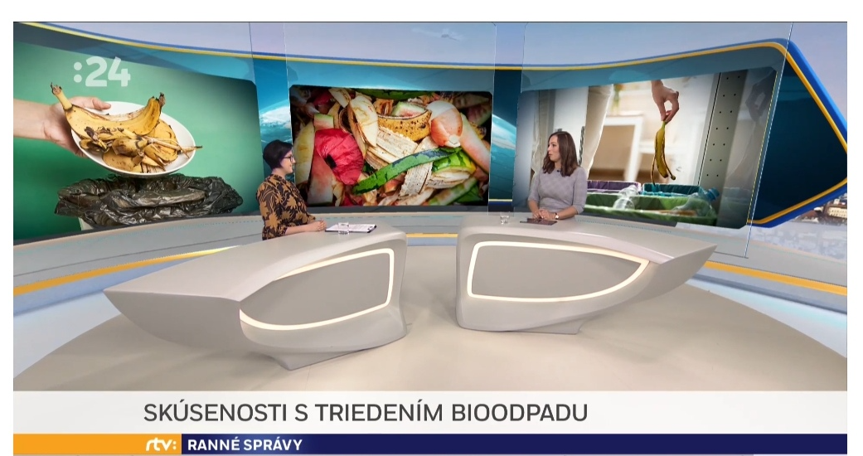
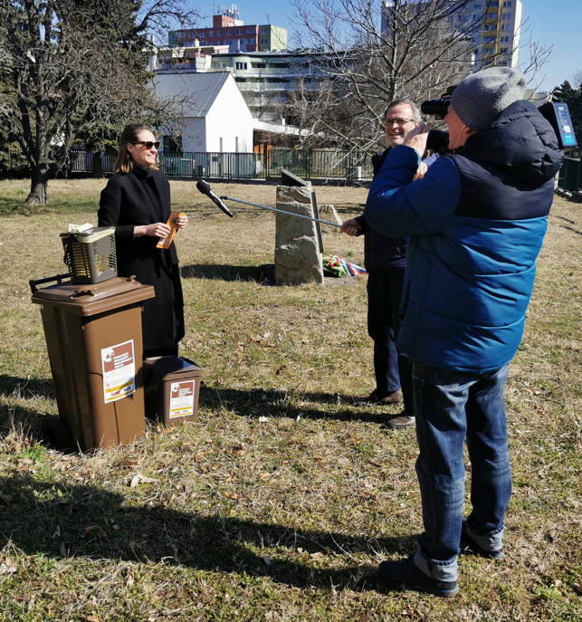
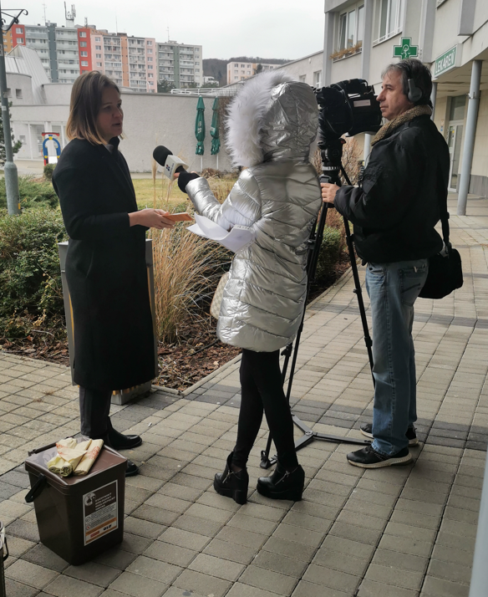
MČ Petržalka
MČ Devínska Nová Ves
MČ Dúbravka
MČ Karlova Ves

Slide 14
RESULTS
More than 140 000 hoseholds are involved in kitchen waste collection (around 65%)
Collection of the kitchen waste in the whole city started in December 2022
OLO collected 10 150 tons of the kitchen waste from beginning of the project
4300 tons was collected in 2022
Almost 6000 tons was collected from january till beginning of Sepetmebre 2023
OLO continues to distribute the compostable bags and kitchen caddys

