Slide 1
ZWE Live webinar
Policy options to tackle overproduction and consumption
Theresa Morsen, Waste Policy Officer 14/03/2023

Slide 2
Overview of policy options
Ban on the destruction of unsold goods
Disincentivising consumption
Extended Producer Responsibility (EPR) schemes
Resource use targets
Support for virtuous business models
Notes:
This is a selection

Slide 3
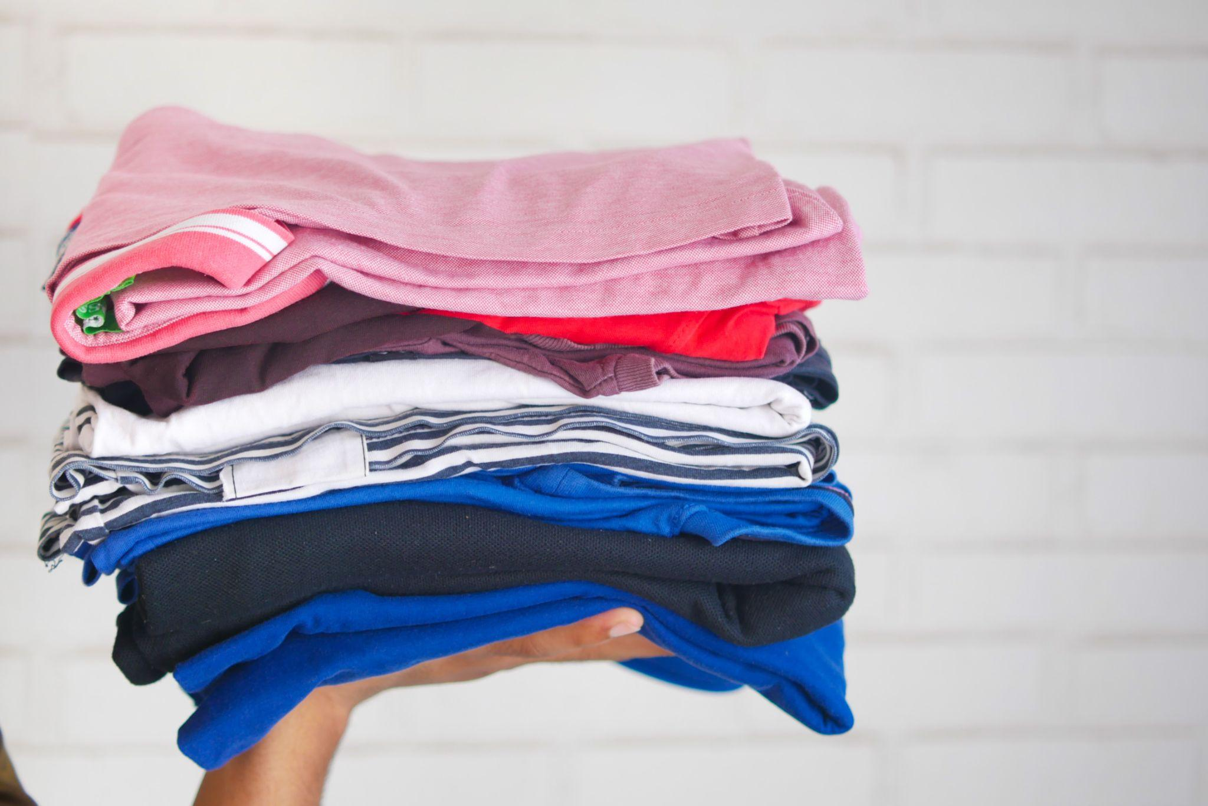
Ban on the destruction of unsold goods
EU Textiles Strategy will mandate the disclosure of the number of discarded products by large enterprises and their subsequent treatment, and measures on banning the destruction of unsold textiles, law expected in 2024;
Scope should include: inventory, deadstock, and returned items;
Issue with ‘exclusive reputation’ of luxury brands but also fast fashion brands;
E-commerce and free returns pose a particular challenge.

Slide 4
Disincentivising consumption
Sufficiency in a fashion and ‘consumption corridors’;
‘Emotional durability’ vs. physical durability via Ecodesign;
Drivers: e-commerce and social media platforms;
Limiting fashion advertisements online and offline, restricting sales times, free returns and next-day delivery;
Positive image of life beyond materialism - schools curricula and public awareness campaigns.

Slide 5
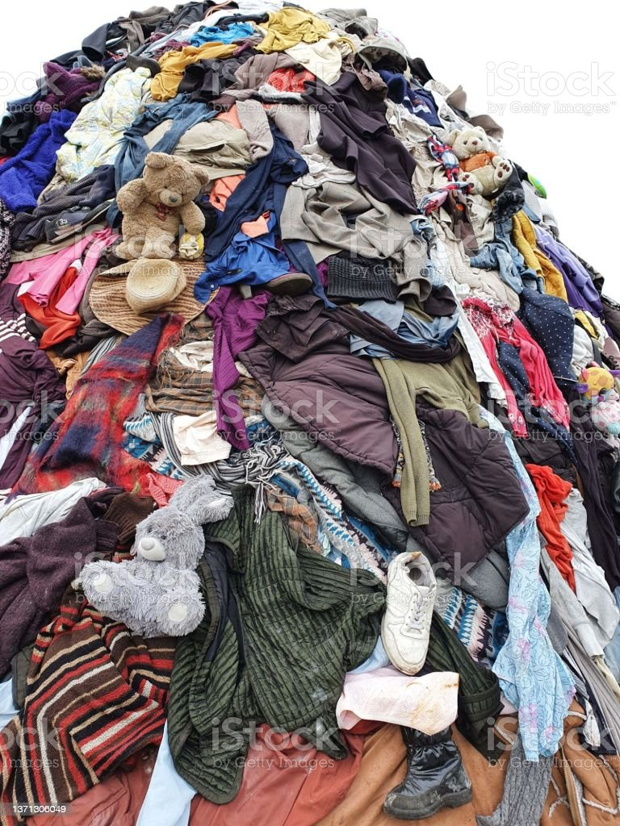
Extended Producer Responsibility (EPR) schemes
Eco-modulation of fees, a levy on certain characteristics of the garments, is currently limited by the provisions in the EU Waste Framework Directive;
Earmarking fees for resource use and waste reduction, reuse systems, setting minimum targets;
Fees as tax on the number of items put on the market: brands could get a bonus for a lower amount of products placed on the market - favouring practices such as leasing, repairing and reusing items.

Slide 6
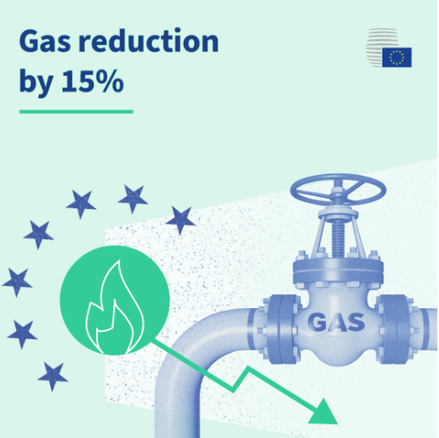
Resource use reduction target
Targets on reuse are not enough;
Take inspiration from measures on gas demand during energy crisis;
Develop methods for establishing clothing, resource, and pollution budgets or limits, in line with carbon budgets;
Set EU-wide quantitative target for material and consumption footprint reduction with specific objectives for textile products for the sector;
Introduction via ESPR or revised WFD?

Slide 7
Support for virtuous business models
Tax rebates and rewards for businesses, funding to sustainable businesses and not-for-profits;
Obligations on businesses to ensure environmental and social value creation;
Starting discussions on limits and production volume caps with fast fashion brands;
Support during transition period from growth business to post-growth;
Facilitating the availability of physical space and accessibility;
Public procurement guidance;
Enhanced support for non-market exchange practices;
Boosting the re-use and repair economy through investigating tax incentives.

Slide 8
Conclusion
The policy options presented can help shift the economy towards production and consumption within planetary boundaries. A well-designed policy mix, carefully calibrating and integrating the different leavers will be necessary to have the desired effect. However, policy alone will not do the trick and significant contributions for sustainable, zero waste, businesses are critical.

Slide 9
References
EEB (2021): Wardrobe Change
UTS Institute for Sustainable Futures, Centre for Innovation Research (CIRCLE) at Lund University and Erasmus University Rotterdam (2022): Wellbeing wardrobe
Vladimirova, Katia (2021): Consumption corridors in fashion: deliberations on upper consumption limits in minimalist fashion challenges
HotorCool Institut Report (2022): Resizing Fashion for a Fair Consumption Space
Eunomia (2022): Driving a Circular Economy for Textiles through EPR
ZWE, EEB, Changing Markets (2022): EPR Briefing
ZWE (2023): Beyond Circular Fashion

