Slide 1
Beyond Circular Fashion
A new business model for the fashion industry
Joan Marc Simon
Director at ZWE

Slide 2
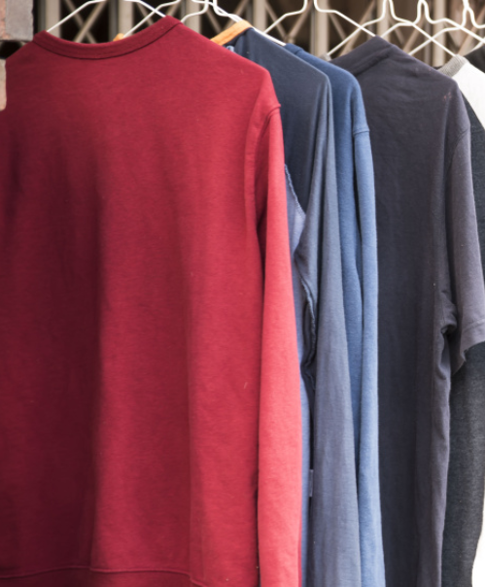
Some data
> 4-10% of global GHG emissions
> 60-400 M workers
> 500 trillion liters of water
> 1600 M of tonnes of materials
X2 production between 2000 and 2015
X3 exports of used clothes from the EU
< 1% recycling
The average European is buying 60% more clothing comparing with 15 years before yet wearing 36% less time.
Add text here

Slide 3
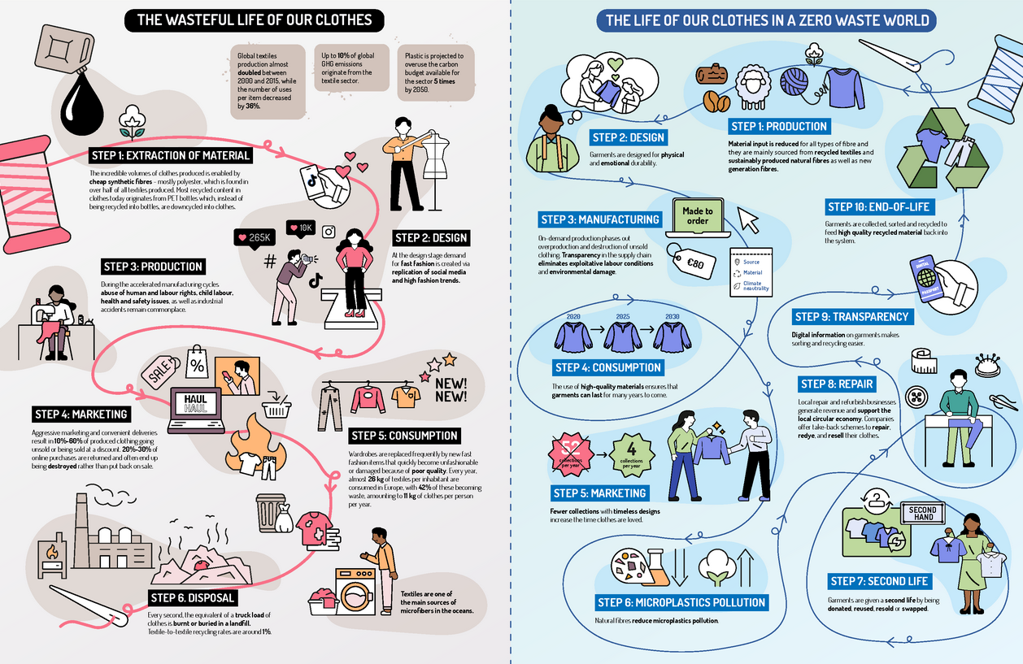
Beyond Circular Fashion - https://zerowasteeurope.eu/wp-content/uploads/2023/03/1956-Beyond-Circular-Fashion-infographic-FINAL.png

Slide 4
Is fast fashion a success, a failure… or both?
It is based on cheap and fast production linked to effective marketing strategies that stimulate consumption.
Three main enablers:
Introduction of synthetic fibers
Externalisation of environmental and social costs from production to disposal
Delocalisation of production

Slide 5
Circularity is key
But is not enough
The importance of tackling overproduction

Slide 6
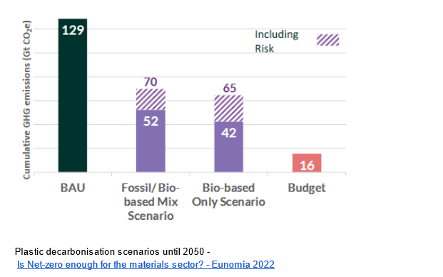

Slide 7
Legislation is key
But it’s not enough

Slide 8
There is no such thing as a sustainable textile product
without a sustainable textiles business model

Slide 9
How would a sustainable, fair, zero waste business model look like?
1- Design for physical and emotional durability
2- Demand driven production - design out unsolds and discounts
3- Full supply chain transparency and traceability post-sale
4- Extend the use-phase after first ownership

Slide 10
Thank you
#beyondcircularfashion
@zerowasteeurope
@JMSimonL
zerowasteeurope.eu

